Slide 1
Modifications in OTE-COM related to the upcoming integration to the single intraday coupling (SIDC)*
OTE, a.s.
Market Participants Training, 8. 10. 2019
* Formerly known as XBID

Slide 2
Overview on modifications in OTE-COM
Content:
Introduction
Main Differences of the SIDC IM to the Current IM
Reports and Capacity Data
Basic Principles of Backup IM and Its Features
General Improvements
Launch of SIDC IM
Conclusion
Strana: 2
Notes:
2

Slide 3
Overview on modifications in OTE-COM
Introduction
Market Integration = Market Coupling = Implicit Allocation
Connection to central XBID solution is the next step in creating connected European intraday electricity market called Single Intra-Day Coupling (SIDC), which is the main goal set in Commission Regulation (EU) 2015/1222 of 24 July 2015 on establishing a guideline on capacity allocation and congestion management (also called CACM)
For markets connected to the Single Intraday Coupling (SIDC), which is based on XBID solution, it is possible to make international trades directly without the necessity of available transfer capacity (ATC) allocation
Strana: 3
Notes:
3

Slide 4
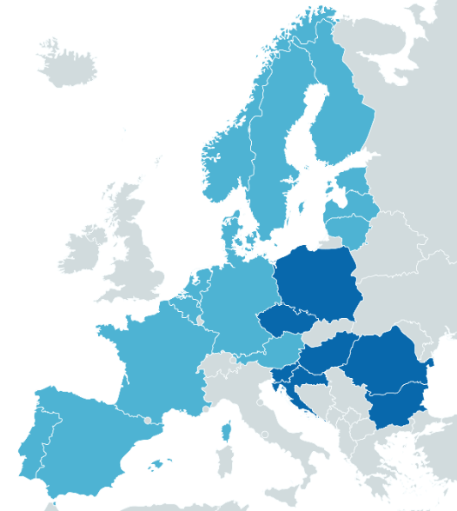
Overview on modifications in OTE-COM
Introduction
2004 – Opening of the trading on the OTE‘s Intraday Market
2012 – Launch of the XBID Project (Cross-Border Intraday Coupling) with the aim „to create joint cross-border implicit trading on intraday European market“ – more information about XBID Project available here.
2016 – Implementation of the trading platform OTE-COM in the OTE‘s system in order to prepare for the 2nd wave go-live of the SIDC
6/2018 – 1st wave go-live of the SIDC (see the picture)
Q4/2019* – upcoming 2nd wave go-live of SIDC in which Bulgaria, Croatia, Poland, Romania, Slovenia and the Czech Republic connect their markets to market areas coupled already in the first wave
Czech bidding zone will be connected to SIDC via CZ-DE, CZ-AT and CZ-PL border
Countries already coupled
Countries preparing for the 2nd wave go-live
* Exact date will be announced in upcoming days
Strana: 4
Notes:
4

Slide 5
Overview on modifications in OTE-COM
XBID Technical Solution
XBID technical solution is based on a common central IT system which aggregates bids from local trading systems operated by nominated electricity market operators (NEMOs), as well as available cross-border transmission capacities between bidding zones provided to the common XBID system by local transmission system operators (TSOs)
Traders insert their bids and participate in trading within the local trading system of each NEMO
Market Participant
Accesses the intraday market
Submits bids to local trading system
Receives trading results
OTE‘s local trading system (OTE-COM)
Shows available cross-border transmission capacities
Receives and validates bids
Presents available offers (not only from the CZ market area)
Manages matched trades
XBID System
Updates current available cross-border transmission capacities
Receives and validates bids from local trading systems
Generates information about available matches
Matches offers
Provides information about matched contracts to local trading systems
Strana: 5
Notes:
5

Slide 6
Overview on modifications in OTE-COM
The intraday electricity market in the Czech Republic will be still operated within the OTE-COM trading platform
IM will be organized:
As a SIDC IM allowing an implicit trading within SIDC, or
As a Backup IM only for the Czech bidding zone, i.e. without the implicit trading – only in exceptional cases when the SDIC IM is not available and implicit trading cannot be performed
With the integration of the existing local intraday market to the interconnected SIDC, based on the XBID technical solution, cross-border transactions can be realized directly without the need to allocate cross-border capacities
Strana: 6
Notes:
6

Slide 7
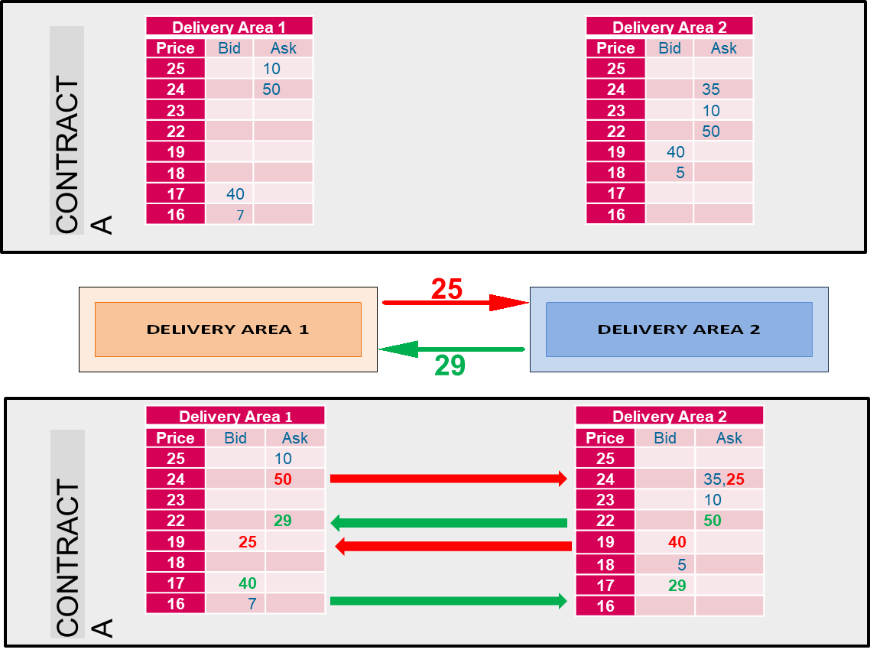
Overview on modifications in OTE-COM
OTE-COM will now also display bids from connected market areas* together with bids entered into the OTE system (without distinction of the market of origin)
Bids placed in the OTE system will be visible* in connected exchange systems.
* Only up to a current available cross border transmission capacity
Strana: 7
Notes:
7

Slide 8
Overview on modifications in OTE-COM
Modifications in OTE-COM concern in particular the following areas:
Modifications in OTE-COM do not concern for example the following areas:
Interface of the OTE-COM
Log in to OTE-COM
Certificates needed for accessing OTE-COM
Registration in the OTE‘s system
Clearing of trades
Strana: 8
Notes:
8

Slide 9
Overview on modifications in OTE-COM
Main Differences of the SIDC IM to the Current IM
Strana: 9
Notes:
9

Slide 10
Overview on modifications in OTE-COM
Overview of changes in OTECOM
Information about the status of the connection to the XBID in OTECOM
Introduction of SIDC contracts
View cross-border capacities (online data + H2H matrix)
Implementation restrictions and linked offers in the basket
Block contract over 2 days delivery
Implementation restrictions and linked offers in the basket
Batch matching
Two-stage financial security of orders
Trade cancel from side of XBID system
New columns in existing reports
Price change attribute limit for ICEBERG
Backup IM
Strana: 10
Notes:
10

Slide 11
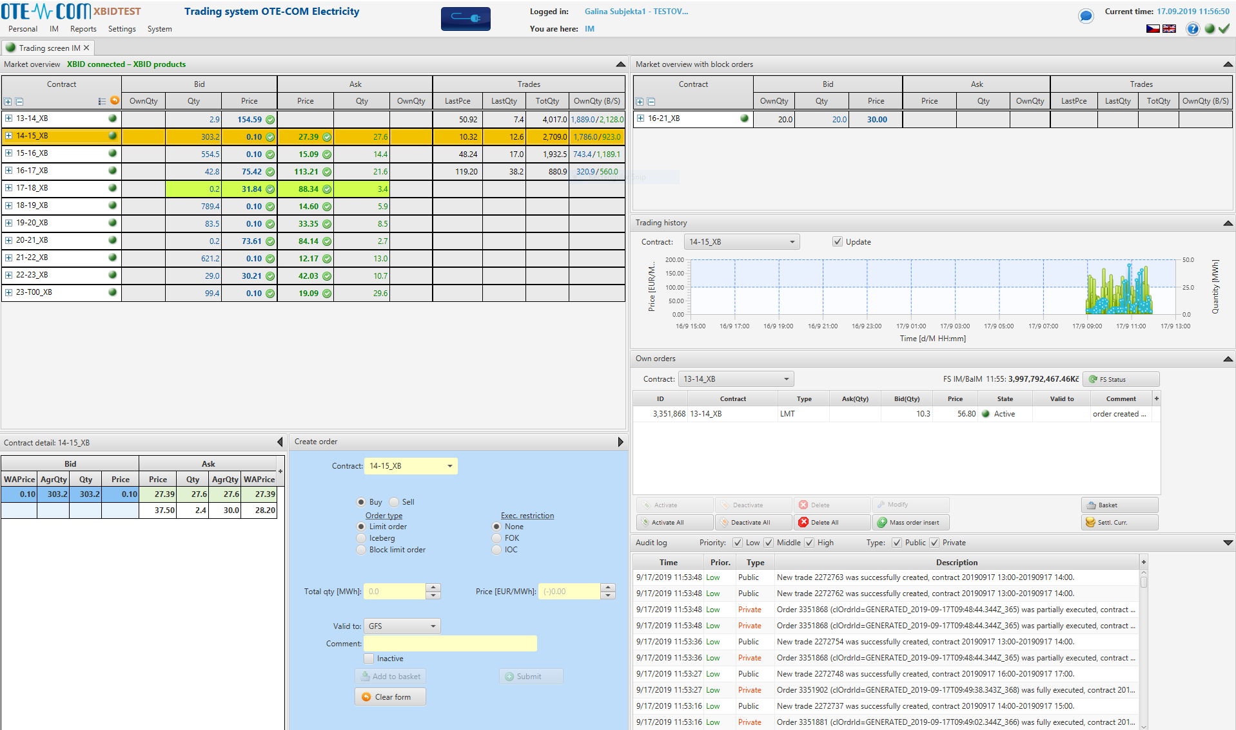
Overview on modifications in OTE-COM
Main Changes of the Trading Screen of SIDC IM
Strana: 11
Notes:
11

Slide 12
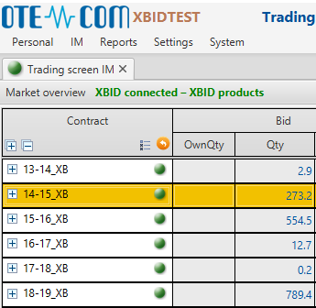
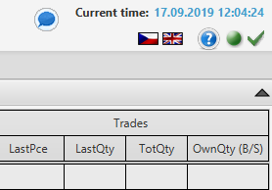
Overview on modifications in OTE-COM
Main Changes of the Trading Screen on SIDC IM
The „traffic light“ signal in the Market Overview tab indicates market participants‘ possibilities to trade (either on SIDC IM connected to XBID or on Backup IM).
Trading is possible (on SIDC IM or Backup IM)
Trading is not possible - connection to XBID is temporarily lost or stopped by the OTE action
The „traffic light“ signal in the running head in upper right corner of the screen indicates connection of the market participant to the OTE-COM server
The symbol next to it indicates connection of the OTE-COM to the XBID system
Strana: 12
Notes:
12

Slide 13
Overview on modifications in OTE-COM
Features Indicating Connection of Market Participant to OTE-COM and OTE-COM to XBID
Market participants will be informed about their connection to OTE-COM server by a „traffic light“ signs in the running head of the OTE-COM
Connection is established
Connection is temporarily lost
System is attempting to reconnect
Connection failed and cannot be established
All active windows are automatically closed and restart of OTE-COM is needed
Market participants will be informed about connection of OTE-COM to XBID system by following symbols in the in the running head of the OTE-COM
Connected to XBID
Connection with XBID lost
Indicated also by a yellow „light“ in Market overview tab
Applies for two situations:
- connection to XBID lost – submission and modification of bids are „waiting in line“ to be performed once the connection is re-established
- connection to XBID stopped by OTE action - submission and modification of bids is not possible
Backup IM activated
No cross-border, only local trading
Strana: 13
Notes:
13

Slide 14
Overview on modifications in OTE-COM
Features Indicating Connection to XBID
Screen of SIDC IM in OTE-COM which depicts availability of implicit trading on SIDC IM connected to XBID market
It is possible to trade XBID Products market connected to XBID is not available and
„XBID connected – XBID Products“ note is displayed Market Overview tab
The „traffic light“ signal in the Market Overview tab is green
There is a green check symbol in the running head
The „traffic light“ signal in the running head depicts the connection of the market participant to OTE-COM
The „traffic light“ signal next to contracts is green
Strana: 14
Notes:
14

Slide 15
Overview on modifications in OTE-COM
Features Indicating Connection to XBID
Screen of SIDC IM in OTE-COM which depicts loss of a connection with the XBID system
It is not possible to submit, modify or null bids in this situation market connected to XBID is not available and
„XBID disconnected – Trading suspended“ note is displayed Market Overview tab
The „traffic light“ signal in the Market Overview tab is yellow
There is a red cross symbol in the running head
The „traffic light“ signal in the running head depicts the connection of the market participant to OTE-COM
The „traffic light“ signal next to contracts is green
Strana: 15
Notes:
15

Slide 16
Overview on modifications in OTE-COM
Features Indicating Connection to XBID
Screen of SIDC IM in OTE-COM which depicts stopping of SIDC IM by the OTE action after the loss of connection to the XBID system
It is not possible to submit, modify or null bids in this situation market connected to XBID is not available and
„XBID disconnected – Trading suspended“ note is displayed Market Overview tab
The „traffic light“ signal in the Market Overview tab is yellow
There is a red cross symbol in the running head
The „traffic light“ signal in the running head depicts the connection of the market participant to OTE-COM
The „traffic light“ signal next to contracts is yellow
Strana: 16
Notes:
16

Slide 17
Overview on modifications in OTE-COM
Features Indicating Connection to XBID
Screen of Backup IM in OTE-COM which has been activated by the OTE action after the loss of connection to the XBID system
The trading is possible in the Backup IM with Backup IM productsmarket connected to XBID is not available and
„XBID disconnected – Backup local IM product“ note is displayed Market Overview tab
The „traffic light“ signal in the Market Overview tab is green
There is a yellow symbol in the running head
The „traffic light“ signal in the running head depicts the connection of the market participant to OTE-COM
The „traffic light“ signal next to contracts is green
Backup IM products are available for the trading (in red colour)
Strana: 17
Notes:
17

Slide 18
Overview on modifications in OTE-COM
Functionality | Main Characteristic / Main Differences
 | Current IM | SIDC IM | Backup IM
Product attributes | Minimal quantity = 1,0 MW | Minimal quantity = 0,1 MW | Minimal quantity = 0,1 MW
 | Maximal quantity = 99 999,0 MW | Maximal quantity = 999,0 MW | Maximal quantity = 999,0 MW
 | Minimal price = - 3500,00 EUR/MWh | Minimal price = - 9 999,00 EUR/MWh | Minimal price = - 9 999,00 EUR/MWh
 | Maximal price = 3500,00 EUR/MWh | Maximal price = 9 999,00 EUR/MWh | Maximal price = 9 999,00 EUR/MWh
Iceberg | Price delta range = NA | Price delta range = 5 EUR/MWh | Peak price delta range = 5 EUR/MWh
 | Min. peak quantity = 1 MW | Min. peak quantity = 5 MW | Min. peak quantity = 5 MW
GTD | Time tick = min. 1 minute | Time tick = min. 5 minutes | Time tick = min. 5 minutes
Block contracts | Only for one day | Possible over two days (i.e. max 30 hours) | Only for one day
Order modification | Orders have the same ID after the modification | If the modification influences matching priority, modified order is created with new ID | Orders have the same ID after the modification
 | During the order activation/deactivation is possible to change another attributes than state of order | During the order activation/deactivation is not possible to change another attributes than state of order | During the order activation/deactivation is possible to change another attributes than state of order
 | During the modification is not possible to change type of order (LMT<=>ICB) | During the modification is possible to change type of order (LMT<=>ICB) | During the modification is possible to change type of order (LMT<=>ICB)
Basket | Only exec. instruction NONE is supported | Basket has exec. instruction NONE, LINKED and VALID | Only exec. instruction NONE is supported
Batch matching | Not supported | Supported | Not applicable
ATC a H2H matrix | Not supported | Supported | Supported, but not applicable
Trade cancel | Not supported | Supported | Not supported
Strana: 18
Notes:
18

Slide 19
Overview on modifications in OTE-COM
Products
Hourly contracts (pre-defined)
Block contracts (user-defined)
Currency EUR
Unit MW
Contract resolution 1 hour
Contracts open for day D 15:00 D-1
Contracts close one hour before delivery time
Long contract name e.g. 20190806 20:00-20190806 21:00
Short contract name e.g. 20-21
In case of unavailability of the SDIC IM and activation of the Backup IM, there will be the so-called Backup IM products, which are defined in the same way as XBID Products, but are only matched locally (see slide 38).
Strana: 19
Notes:
19

Slide 20
Overview on modifications in OTE-COM
Order Modification Behaviour
In case of order modification which has impact on matching priority (e.g. change of price or quantity), XBID solution changes order ID and its version (for XBID such order modification is the same as activation or deactivation of the order). Another modification within IM is possible only after previous modification is accepted by XBID successfully (the last actual order ID and version is known within OTE-COM)
In case of order modification which has no impact on matching priority, version is updated and order ID stays the same
In case of activation/deactivation of an order it is not allowed to change any other attributes of the order
In case of an order modification it is not allowed to change this attributes:
Buy/Sell
Contract
Order ID
Execution restriction (in case of Iceberg and Block order)
An order modification is not possible if:
Is deleted,
Is closed for trading (its parameter Valid has expired),
OTE-COM has not received response from XBID for the previous order modification request.
Strana: 20
Notes:
20

Slide 21
Overview on modifications in OTE-COM
Block Contracts Improvements
It will be possible to define block contracts in the SDIC IM, which:
span over two consecutive days of delivery,
have maximum length of 30 hours.
Block contracts will continue to be displayed in the „Block Contract Summary“ panel, as currently in OTE-COM
1. day of delivery
2. day of delivery
Block contract 01-T04
= 28hour block contract (delivery from 1st hour of day 1 to 4th hour of the next day)
Strana: 21
Notes:
21

Slide 22
Overview on modifications in OTE-COM
Block Contracts Improvements
Time – Block contracts for SIDC IM can span over up to 30 hours. It means there can be blocks over the midnight.
Total Quantity – quantity of both buy and sell site of block trades for the given block contract. In case of international block trades only quantity of one site of such trades is included.
Strana: 22
Notes:
22

Slide 23
Overview on modifications in OTE-COM
Batch matching
Batch matching is implemented in the XBID technical solution for situations when transmission capacities on cross-border profiles increase and other more suitable bids could be potentially traded through the extended cross-border profile
In these cases batch matching is launched automatically
Continuous matching is suspended for the very short duration of the batch matching, new bids are aggregated in the queue and are handled according to standard continuous matching rules after finalization of batch matching
Pricing rules in batch matching are different from those in continuous matching, depending on the limit prices of bids entering into this "auction" and on the regional prices in which bids were placed
Resulting trade price applies for all trades matched during the session of batch matching
Market participant is informed about launch and finalization of batch matching in audit log
Trades made during the batch matching process are visible in IM Trades by delivery day report with the value „Batch matching“ in column Trading phase
Strana: 23
Notes:
23

Slide 24
Overview on modifications in OTE-COM
Basket Execution Restrictions
System will allow for a bulk management of bids by execution instruction defined for the whole basket:
Unlimited (NONE)
No execution restriction is applied
All bids in a basket will be executed as if they were entered into the basket separately
If one bid fails in the validation procedure other bids in the basket will not be affected
Linked bids (LINKED)
All bids in the basket must be traded immediately and in full after successful validation (FOK restriction)
If one bid of a given basket cannot be fully matched all other bids in the basket will be deleted
This restriction can only be set if the Iceberg bid has not been added to the basket (FOK restriction is not supported for Iceberg offers)
Valid bids (VALID)
Each bid needs to successfully undergo validation in order to have all bids added to the matching system
Change all to FOK
This button sets execution restriction to FOK for all orders in the basket
If there is any single Block or ICB order listed in the basket, action is not done and error message is shown.
Strana: 24
Notes:
24

Slide 25
Overview on modifications in OTE-COM
Trade Cancellation by XBID system
Trade cancelling process is initiated by the XBID System
Reason for a trade cancellation is always a faulty trade creation because of malfunctioning of XBID system and therefore a trade cancellation serves only as an exceptional measure
Trade cancellation by market participant is not supported within SIDC IM or Backup IM in OTE-COM
Cancelled trade has the status „CNCL“
Strana: 25
Notes:
25

Slide 26
Overview on modifications in OTE-COM
Reports and Capacity Data
Strana: 26
Notes:
26

Slide 27
Overview on modifications in OTE-COM
Network Capacity Data
Capacity data are presented as:
Online data
for hours corresponding to open contracts
updated in real time (live)
Historical static data
last known capacity data snapshot for intervals corresponding to closed contracts
historical data are presented within these reports:
ATC Data
Hub to Hub Matrix (H2H)
Strana: 27
Notes:
27

Slide 28
Overview on modifications in OTE-COM
Online Capacity Data
Online capacity data are presented via Hub to Hub Online Matrix
The matrix presents available capacities between CZ delivery area and other SIDC delivery areas in form of Hub2Hub Online Matrix calculated by XBID considering all available allocation paths
H2H Online Matrix is available as optional panel for user defined trading screen layout
Data are updated in real time, automatically as they change
After contract closure, its delivery interval disappears from the matrix (and become subsequently visible in H2H matrix report)
Data are presented in two ways:
By delivery area – chosen delivery area to/from other delivery areas for all delivery intervals which are open for trading
By period – the data for all contracts open for trading for a chosen day and delivery interval are shown, no data are shown in case of selection of delivery interval which is not open for trading
Strana: 28
Notes:
28

Slide 29
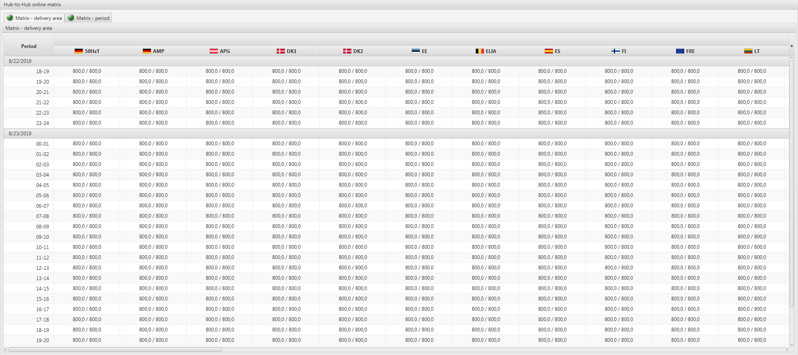
Overview on modifications in OTE-COM
H2H Online Matrix – Delivery Area
Strana: 29
Notes:
29

Slide 30
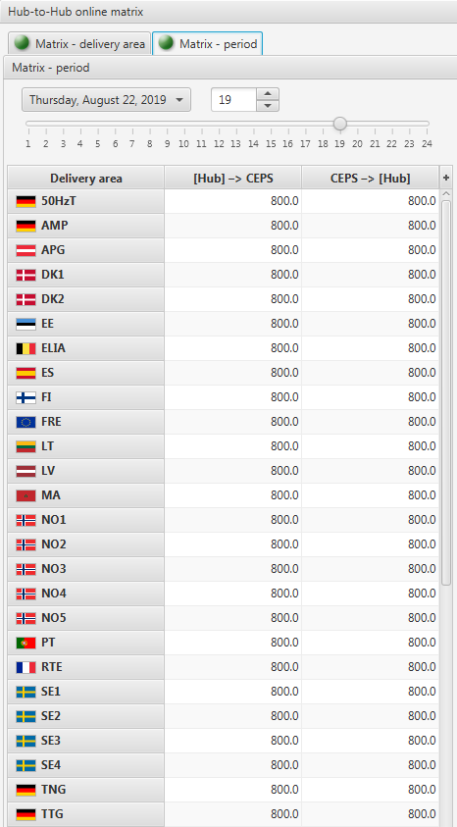
Overview on modifications in OTE-COM
H2H Online Matrix – Period
Strana: 30
Notes:
30

Slide 31
Overview on modifications in OTE-COM
Hub-to-Hub Matrix
Report shows historical data of available capacities between CZ delivery area and other SIDC delivery areas in form of Hub-to-Hub matrix calculated by XBID considering all available allocation paths.
In report only last known H2H data are shown for already closed contracts of chosen delivery day(s).
To see live H2H matrix of being traded contracts the online H2H matrix pane can be used within user defined trading screen layout.
The form provides two ways of Hub-to-Hub matrix presentation:
By trading area – on bookmark Matrix - delivery area: H2H capacity data of Czech delivery area to/from other delivery areas for all delivery intervals of chosen range of delivery days are shown, only intervals closed for trading are included.
By period – on bookmark Matrix – period: H2H capacity data of Czech delivery area to/from other delivery areas for chosen delivery day and interval are shown, in case of selection of delivery interval which is still open for trading no data are shown.
Strana: 31
Notes:
31

Slide 32
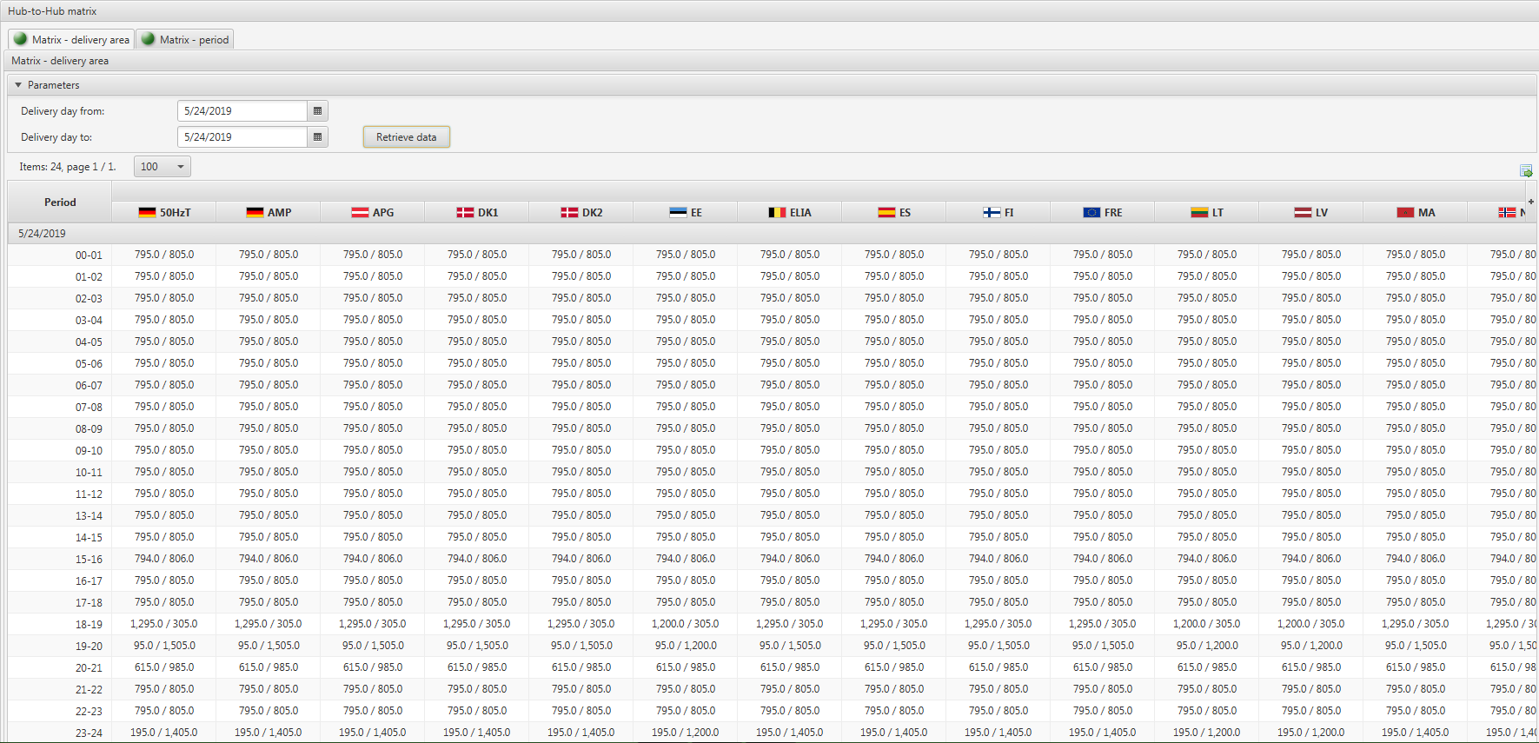
Overview on modifications in OTE-COM
H2H Matrix – Delivery Area
Strana: 32
Notes:
32

Slide 33
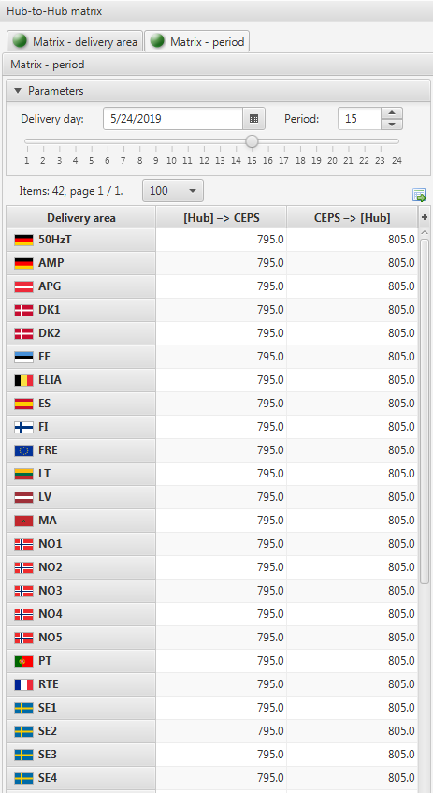
Overview on modifications in OTE-COM
H2H Matrix - Period
Strana: 33
Notes:
33

Slide 34
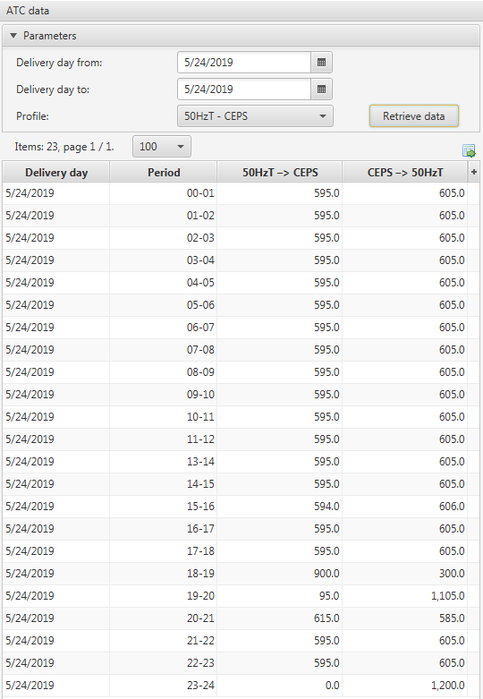
Overview on modifications in OTE-COM
ATC Data
Report shows historical ATC values for every interval of delivery day between chosen connected delivery areas for which were ATC data provided by XBID
Report shows values for intervals of chosen delivery day/s for which corresponding contracts are in the state Close for trading
Strana: 34
Notes:
34

Slide 35
Overview on modifications in OTE-COM
New Columns in Existing Reports
IM Contract List
Delivery day from
Delivery day to
IM Bids by Delivery Day
Short contract name
Initial order ID
Parent order ID
Delivery day from
Delivery day to
Basket ID
Basket execution instruction
Priority TS
Strana: 35
Notes:
35

Slide 36
Overview on modifications in OTE-COM
New Columns in Existing Reports
IM Trades by Delivery Day
Short contract name
Trade version
Delivery day from
Delivery day to
Trade state
Trading phase
IM Results
Delivery day
Contract
IM Trades Overview
Short contract name
Delivery day from
Delivery day to
Strana: 36
Notes:
36

Slide 37
Overview on modifications in OTE-COM
Total IM Results
Report shows list of aggregated trading results for Czech area with hourly and block contracts
In case both SIDC IM and Backup IM were active within selected period aggregated data of both are presented
Values of block contracts are broken down into individual hours to be shown in hourly matrix
Results are based only on valid (excluding successfully cancelled) national or cross-border trades of Czech market participants
Strana: 37
Notes:
37

Slide 38
Overview on modifications in OTE-COM
Basic Principles of Backup IM and its Basic Features
Strana: 38
Notes:
38

Slide 39
Overview on modifications in OTE-COM
Backup Intraday Market
So called Backup IM is activated when the SDIC IM is not available and implicit trading cannot be performed
Backup IM slightly differs from the SIDC IM connected to XBID in several parameters:
When trading on the Backup IM, bids can only be matched locally, i.e. it will not be possible to trade cross-border
The Backup IM product, which is defined similarly to the "XBID product" will be activated for the Backup IM.
Block bids over two days of delivery cannot be placed on the Backup IM, block bids can only be submitted within one delivery day, i.e. for a maximum of 24 hours
When the Backup IM is activated, the execution restriction “NONE” will be automatically set for the whole basket, i.e. no execution restriction will be set for the given basket.
When Backup IM is activated:
bids placed in the IM with implicit allocation cannot be managed, modified or cancelled any more
new bids will have to be submitted (using Backup IM products)
Batch matching is not performed on Backup IM
Strana: 39
Notes:
39

Slide 40
Overview on modifications in OTE-COM
Functionality | Main Characteristic / Main Differences
 | Current IM | SIDC IM | Backup IM
Product attributes | Minimal quantity = 1,0 MW | Minimal quantity = 0,1 MW | Minimal quantity = 0,1 MW
 | Maximal quantity = 99 999,0 MW | Maximal quantity = 999,0 MW | Maximal quantity = 999,0 MW
 | Minimal price = - 3500,00 EUR/MWh | Minimal price = - 9 999,00 EUR/MWh | Minimal price = - 9 999,00 EUR/MWh
 | Maximal price = 3500,00 EUR/MWh | Maximal price = 9 999,00 EUR/MWh | Maximal price = 9 999,00 EUR/MWh
Iceberg | Price delta range = NA | Price delta range = 5 EUR/MWh | Peak price delta range = 5 EUR/MWh
 | Min. peak quantity = 1 MW | Min. peak quantity = 5 MW | Min. peak quantity = 5 MW
GTD | Time tick = min. 1 minute | Time tick = min. 5 minutes | Time tick = min. 5 minutes
Block contracts | Only for one day | Possible over two days (i.e. max 30 hours) | Only for one day
Order modification | Orders have the same ID after the modification | If the modification influences matching priority, modified order is created with new ID | Orders have the same ID after the modification
 | During the order activation/deactivation is possible to change another attributes than state of order | During the order activation/deactivation is not possible to change another attributes than state of order | During the order activation/deactivation is possible to change another attributes than state of order
 | During the modification is not possible to change type of order (LMT<=>ICB) | During the modification is possible to change type of order (LMT<=>ICB) | During the modification is possible to change type of order (LMT<=>ICB)
Basket | Only exec. instruction NONE is supported | Basket has exec. instruction NONE, LINKED and VALID | Only exec. instruction NONE is supported
Batch matching | Not supported | Supported | Not applicable
ATC a H2H matrix | Not supported | Supported | Supported, but not applicable
Trade cancel | Not supported | Supported | Not supported
Strana: 40
Notes:
40

Slide 41
Overview on modifications in OTE-COM
Products of Backup IM
Hourly contracts (pre-defined)
Block contracts (user-defined)
Currency EUR
Unit MW
Contract resolution 1 hour
Contracts open for day D 15:00 D-1
Contracts close one hour before delivery time
Long contract name e.g. Contract IM_1H_1982019_00-01 of delivery electricity in hour 00-01 of 2019/08/19
Short contract name e.g. Hourly contract IM_1H_19082019_00-01 - base
Strana: 41
Notes:
41

Slide 42
Overview on modifications in OTE-COM
Switching from SIDC IM to Backup IM and vice versa in case of loss of a connection to or failure of the XBID system
If OTE-COM detects loss of a connection to the XBID system or a failure of the XBID system the trading on SIDC IM is automatically stopped
Bids and available contracts are automatically deactivated
Strana: 42
Notes:
42

Slide 43
Overview on modifications in OTE-COM
Switching from SIDC IM to Backup IM and vice versa in case of loss of a connection to or failure of the XBID system
Market participants are informed about the temporary unavailability of the XBID system and therefore about stopping of the SIDC IM by the message sent out by OTE
When SIDC IM is deactivated activation of Backup IM might follow
Market participants are informed about the activation of the Backup IM by the message sent out by OTE
Strana: 43
Notes:
43

Slide 44
Overview on modifications in OTE-COM
Switching from SIDC IM to Backup IM and vice versa in case of loss of a connection to or failure of the XBID system
Once the availability of the XBID system is re-established,Backup IM is deactivated and SIDC IM is activated.
Market participants are informed about the switch by a message sent out by OTE.
Market participants are also informed about the fact that bids of the SIDC IM have been deactivated, so bids can be activated again by market participants.
Strana: 44
Notes:
44

Slide 45
Overview on modifications in OTE-COM
General Improvements
Strana: 45
Notes:
45

Slide 46
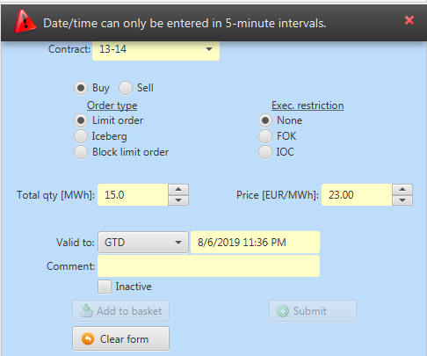
Overview on modifications in OTE-COM
GTD – Good till Date
Checking of time tick for time restriction GTD (checking is done automatically after filling the time and leaving the field)
Time of order validity has to follow defined time tick (5 minutes)
If the check is unsuccessful an error message is shown on the form: „Date/time can only be entered in 5-minute intervals“.
Strana: 46
Notes:
46

Slide 47
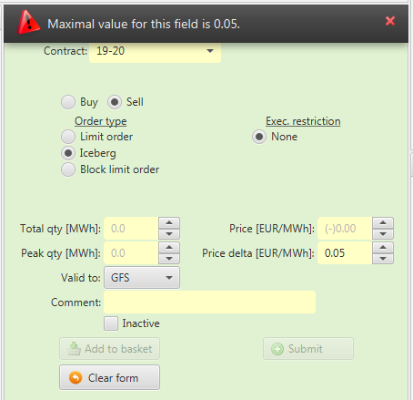
Overview on modifications in OTE-COM
Iceberg: Checking of Price and Price Delta attribute
Price defined in buy/sell order has to follow XBID product parameters:
Minimal Price: -9 999,00 EUR/MWh
Maximal Price: 9 999,00 EUR/MWh
Price Tick: 0,01 EUR/MWh
Price delta has to follow XBID product parameters:
Buy order: Negative value including zero -> ranging from 0 to -5 Eur/MWh
Sell order: Positive value including zero -> ranging from 0 to 5 Eur/MWh
Price Tick: 0,01 EUR/MWh
Checking of Price delta is done only for Iceberg orders
Values of the attributes have to be filled in the appropriate fields of the Create order form
E.g.: After filling value for Price delta not compliant with Peak Price Delta Range (defined by XBID) an error message with the limit for the field is shown in a form: „Maximal value for this field is 5“ and max. value will be automatically inserted.
Strana: 47
Notes:
47

Slide 48
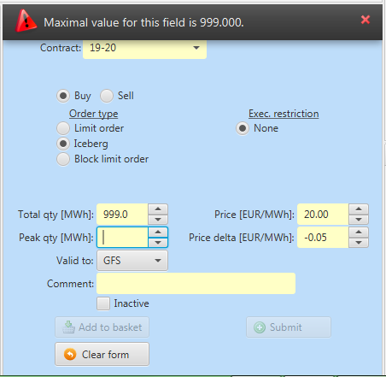
Overview on modifications in OTE-COM
Iceberg: Checking of Total Quantity and Peak Quantity
Total quantity defined in buy/sell order has to follow XBID product parameters:
Minimal Quantity: 5,0 MW
Maximal Quantity: 999,9 MW
Quantity Tick: 0,1 MW
Peak quantity has to follow XBID product parameters:
Minimal Quantity: 5,0 MW
Maximal Quantity: must not exceed the total quantity of an order.
Quantity Tick: 0,1 MW
Checking of the Peak quantity attribute is done only for Iceberg orders
Values of the attributes have to be filled in the appropriate fields of the Create order form
E.g.: After filling number „1500“ to this field and clicking to another field an error message with the limit of the field is shown in a form: „Maximal value for this field is 999,000“ and max. value will be automatically inserted.
Strana: 48
Notes:
48

Slide 49
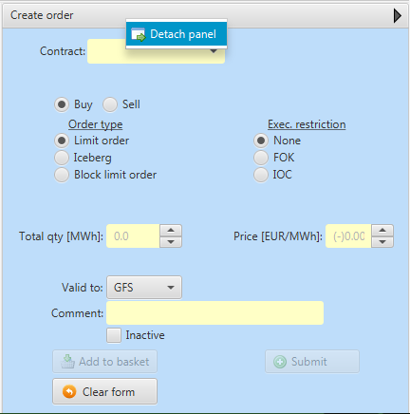
Overview on modifications in OTE-COM
Detach Panel
Individual panels of trading screen can be detached and moved to another place of trading screen (without creating new „own screen“)
Panel detaching option „Detach panel“ is available on mouse right click over the panel.
Strana: 49
Notes:
49

Slide 50
Overview on modifications in OTE-COM
Fast Filter
Fast Filter
Fast filter button shows fields for filtering data listed an a report
For columns with list of values a list is shown
For other columns there is a text field
For deleting of set fast filter there is button
Strana: 50
Notes:
50

Slide 51
Overview on modifications in OTE-COM
Slider
Slider – new graphic component used for data selection (for setting delivery interval by sliding point).
Data are updated when changing position of the slider point and when the slider point is not moved for another 0,5 to 1 s.
Component dynamically recognizes number of hours for chosen delivery day to reflect winter/summer switch days.
Strana: 51
Notes:
51

Slide 52
Overview on modifications in OTE-COM
Export and Export All Data
Export Data
Used for data export of a selected report
It exports a maximum of 2000 entries for the report.
After clicking on the icon is opened pop up window for exporting data which can be exported in the following formats:
MS Excel (Default setting)
PDF
TXT
XML
Export All Data
Data is exported to MS Excel format
Export of all data is set for the following reports:
IM Trades by delivery day
IM Trades overview
Strana: 52
Notes:
52

Slide 53
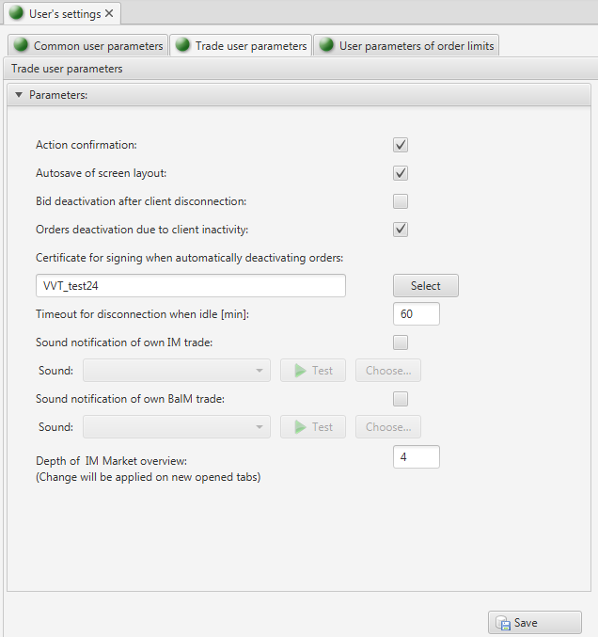
Overview on modifications in OTE-COM
Extended Options in Trade User Parameters
Certificate for signing when automatically deactivating orders – this parameter defines user certificate used for signing in case of automatic deactivation of active orders due to long user inactivity. Certificate can be set only in case that parameter Orders deactivation due to client inactivity is set on.
Depth of IM market overview – this parameter defines depth of detail shown in Market overview in IM screen. Implicitly is set on 4 (it means 4 orders with the lowest price for sell and 4 orders with highest price for buy). Range of this parameter is 2-10.
Strana: 53
Notes:
53

Slide 54
Overview on modifications in OTE-COM
Financial security
The impact on financial security is re-evaluated with each new order issued by one market participant (such as bid submission, bid modification etc.) according to the following rules:
Should a new order or its modification reduce the amount of available funds from trading limit, the change of blocked amount is made immediately.
Should the order modification increase the amount of available funds from the trading limit, the change of blocked amount will not be made yet and the original version of the order will remain secured. The change of blocked amount takes place only upon the confirmation from the XBID system.
If the trade is canceled by the XBID system the blocked amount of trading limit will be re-evaluated.
Strana: 54
Notes:
54

Slide 55
Overview on modifications in OTE-COM
Launch of SIDC IM
Strana: 55
Notes:
55

Slide 56
Overview on modifications in OTE-COM
Next steps
14th – 25th October 2019
Testing with market participants
November 2019
Go-live of single intraday market coupling (SIDC)
Week 43 – Detailed plan of the Trial Period* :
Monday 21.10. 2019 Normal operations
Tuesday 22.10.2019 Normal operations
Closing of HU market
Wednesday 23.10.2019 Normal operations
Trade cancellation
Closing of markets
Thursday 24.10.2019 Normal operations
Trade cancellation
Closing of borders
Friday 25.10.2019 No testing planned
Week 44 – reserved for additional testing if activated by the SIDC project
* For more information please see the SIDC presentation for Pre-Launch Event
Strana: 56
Notes:
56

Slide 57
Overview on modifications in OTE-COM
Using Backup IM during the Process of Switching to XBID
Switching to SIDC IM in 2 phases:
1st Phase: During the maintenance window planned 14th November 2019* the above changes will be implemented in the OTE-COM and intraday market will be temporarily operated in the Backup IM mode.
2nd Phase: During 19th November 2019* trading on the Backup IM will be stopped and subsequently connection to XBID platform and the IM operation within SIDC will be launched (further details will be communicated well in advance).
19. 11. 2019
Launch of SIDC IM
14. 11. 2019 Maintanance window
2nd Phase
1st Phase
Trading on SIDC IM with connection to XBID
XBID products available
Current IM
Trading on Backup IM without connection to XBID
Backup products available
*Please note these dates are subject to final confirmation
Strana: 57
Notes:
57

Slide 58
Overview on modifications in OTE-COM
Using Backup IM during the Process of Switching to XBID
1st Phase
XBID compatible IM release to be done within OTE maintenance window (few days before actual go-live)
Market participants need to adapt their systems (if applicable) to interface changes
Once XBID compatible IM is up and running, it will be in Backup IM mode to trade local national contracts independently of XBID (there will not be an available cross-border capacity yet)
2nd Phase
Switch to XBID means to stop trading with Backup IM contracts and start trading with XBID contracts in the SIDC IM
It will be announced upfront which Backup IM contract will be the last one and which XBID contract will be the first one to start cross-border trading within SIDC IM.
Backup IM orders/trades will not be transferred to XBID
In case of unsuccessful connection to XBID, the Backup IM will be used again as a rollback solution
Strana: 58
Notes:
58

Slide 59
Overview on modifications in OTE-COM
Conclusion
Strana: 59
Notes:
59

Slide 60
Overview on modifications in OTE-COM
Questions and Answers
…
…
…
Strana: 60
Notes:
60

Slide 61
Thank You for your attention…
OTE, a.s. - Provider of comprehensive services for the Czech electricity and gas market:
Reliable processing and exchange of data and information in the energy sector through the Centre of Data and Information Services, 24 hours a day, 7 days a week.
Organization of the short-term electricity and gas market.
Clearance and financial settlement of imbalances between the contracted and the actual electricity and gas supplies and purchases.
Provision of technical and organizational backup for the change of the electricity and gas supplier.
Administration of the national registry for trading of greenhouse gas emission units and allowances.
OTE, a.s.
Sokolovská 192/79
Prague 8
Czech Republic
Tel.: +420 296 579 160
www.ote-cr.cz
market@ote-cr.cz
xbid@ote-cr.cz
Notes:
61

