Slide 1
OTE-COM Application
News – User defined Blocks on IM

Slide 2
New functions connected to UD Blocks on IM
Following slides show the most important changes in OTE-COM application connected to prepared implementation of User defined Blocks on IM.
It is mainly Trading screen – new panel Market overview with block orders.
Content of panels Trading history, Own orders and Create order varies depending on in which Market overview market participant is.
Detailed information will be in draft of User manual that will be available for market participants since 2 p.m. on Friday 11. 11. 2016.
The launch date of UD Block trading, no earlier than 23rd November 2016, will be communicated to market participants in advance.

Slide 3
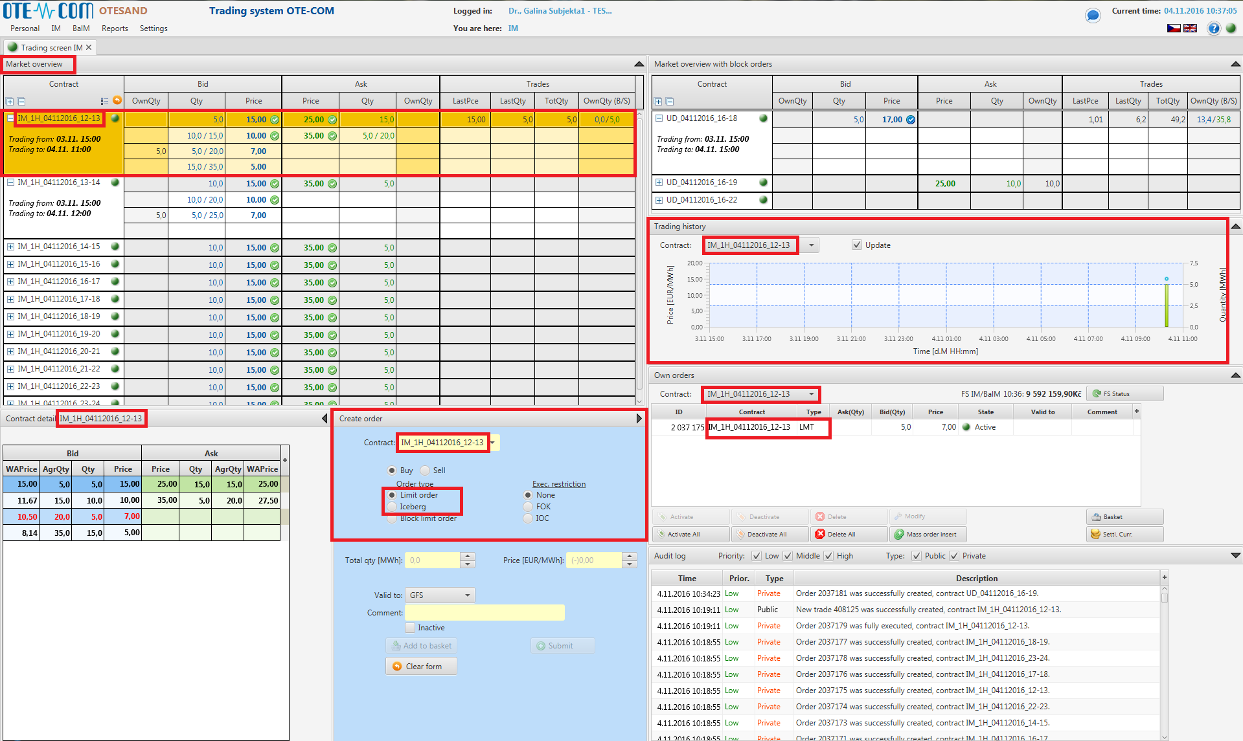
Trading screen – Hourly contracts
Market overview
Selected hourly contract.
Trading history
Quantity/Price chart of trades in selected hourly contract.
Own orders
Overview and administration of own orders in selected hourly contract.
Create order
Form for creating of new order in selected hourly contract.

Slide 4
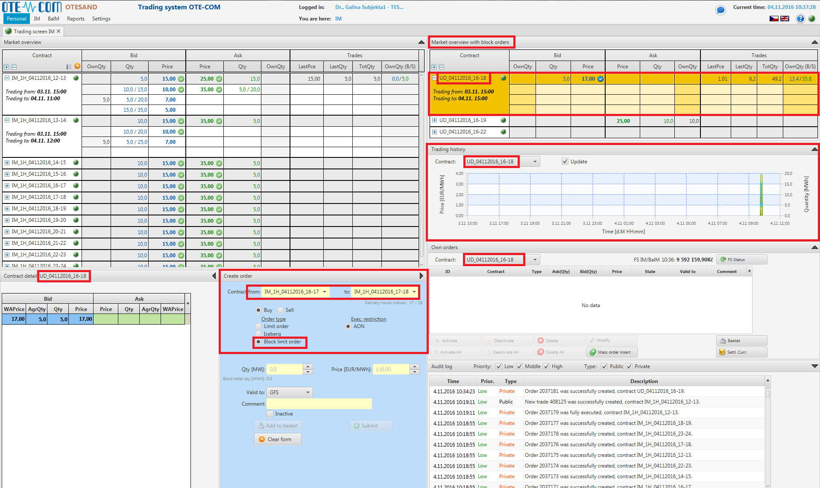
Trading screen – User defined Block contracts
Market overview with block orders
Selected Block contract.
Trading history
Quantity/Price chart of trades in selected Block contract.
Own orders
Overview and administration of own orders in selected Block contract.
Create order
Form for creating of new order in selected Block contract

Slide 5
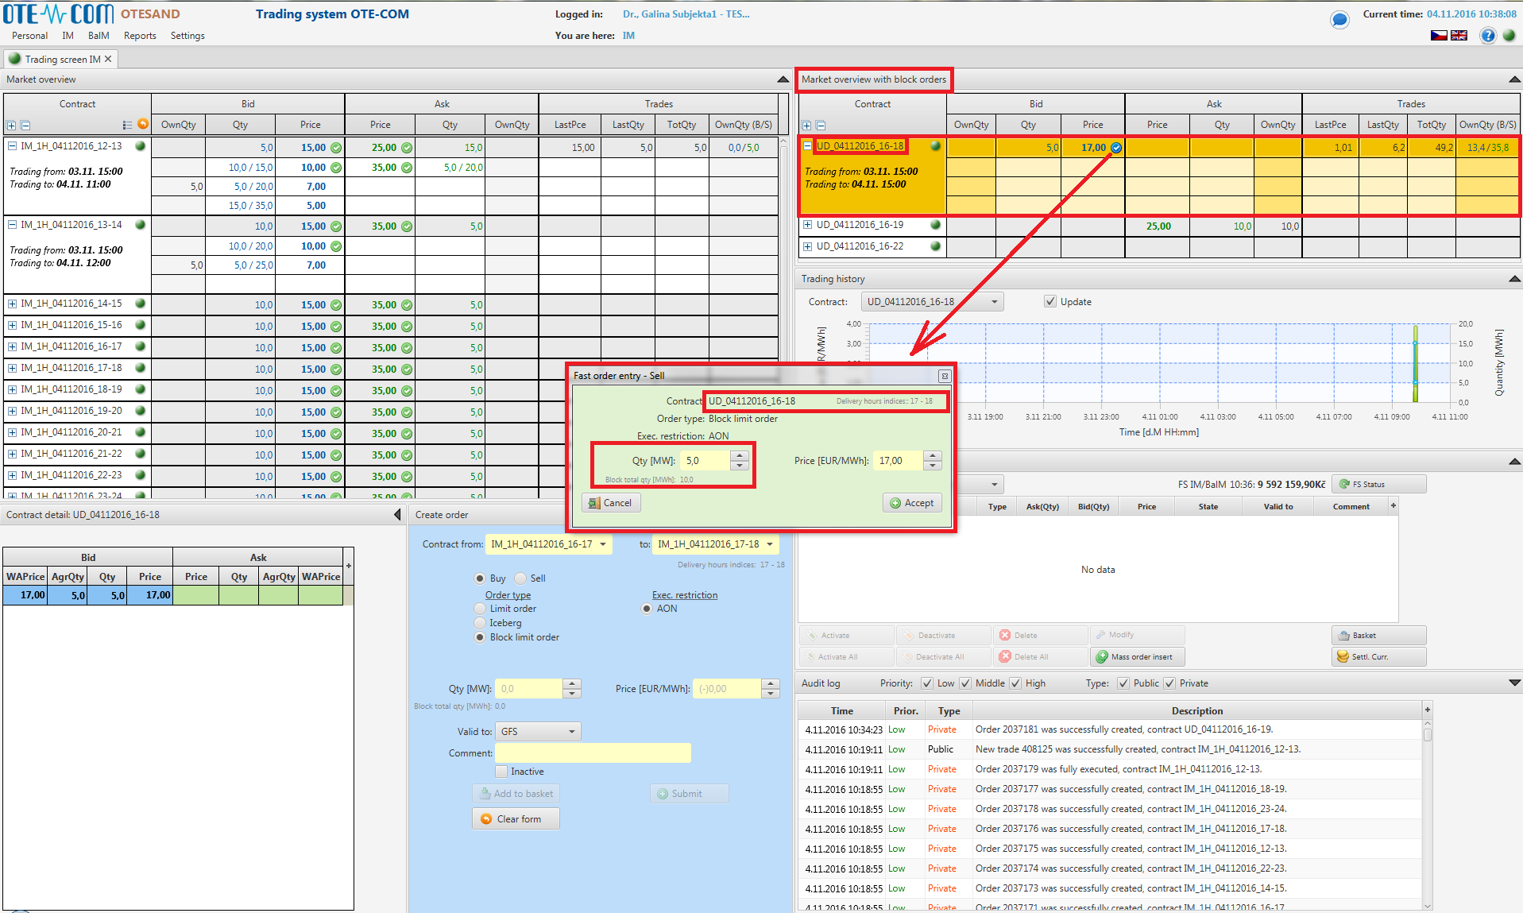
UD Block contracts – Fast order entry
Market overview with block orders
Selected Block contract.
Fast order entry
After clicking on the blue icon pops up window Fast order entry.
Acceptation of Fast order
Creating a counter-order that can be paired.

Slide 6
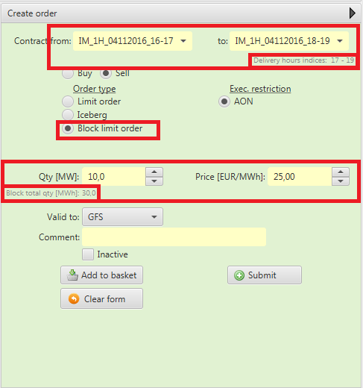
UD Block contracts – Create order
Contract creation
Selecting the starting and ending hour of Block contract.
+ Check of the time range of the Block using hour indices.
Restriction of Block orders
Restrictions AON allows trading blocks of the same size and the corresponding price.
Price and quantity
Entering price and hourly amount of order in selected Block contract.
+ Check of the total amount in the block.
Create order
Form for creating of new order in selected Block contract.

Slide 7
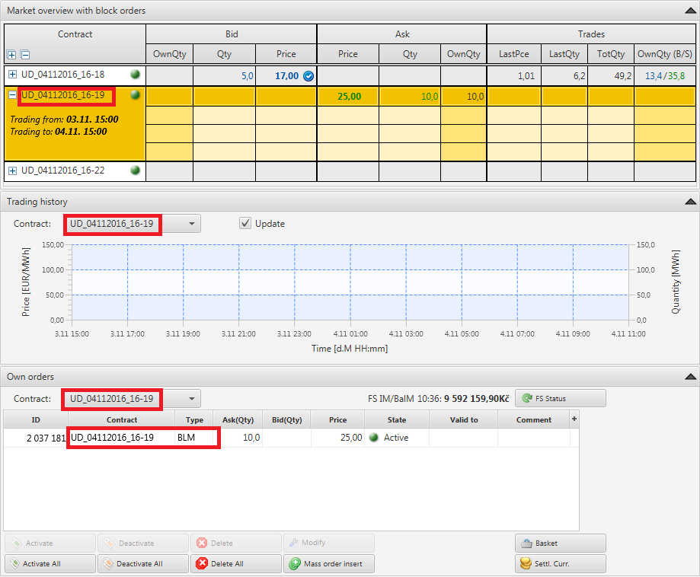
UD Block contracts – overview, history and administration
Market overview with block orders
Selected Block contract.
Trading history
Quantity/Price chart of trades in selected Block contract.
Own orders
Overview and administration of own orders in selected Block contract.

Slide 8

spot-markets@ote-cr.cz

